Slide 1

BLOOD-D
Team Members:
Jayanthi.M -18BCS075
Deepthi.P -18BCS111
Shilpashri.M -18BCS122
Esaiarasi.S -18BCS105

Slide 2
OBJECTIVE
This project aims at maintaining all information regarding blood donors, different blood groups available inblood banks as wells as blood camps and help them manage in a better way.
This online blood donation management system maintains the list of blood donors and also helps the recipients to track and search the right donor easily.

Slide 3
INTRODUCTION
* Blood donation is required during the organ transplant,accidents and cancer treatments etc.For blood donation,one needs to check for a
donation camp or needs to visit a blood camp.
*The Manual Blood donationsystem has many disadvantages like,it comsumes lots of manpower,percentage of accuracy is less, etc.In the time of emergency, it becomes difficult to approach the right donor.Rare blood groups are not available all the time at all blood banks.
*This system that not only maintains the information of blood banks but also maintains information about blood camps which makes the blood transfusion process easier.

Slide 4
PURPOSE
It reduces the time of searching donor for the patient. The hostpital can directly contact the donor which reduces the time for searching a bood donor during an emergency case.

Slide 5
PROS
* Recipients can get blood easily.
* In case of emergency, if the blood group is rare, he/she can find for the certain blood group donor.
* Donors can also donate blood easily by checking the list of blood donation camps.
CONS
* No proper coordination between different applications and users.
* Cannot upload and download the latest updates at right time.

Slide 6
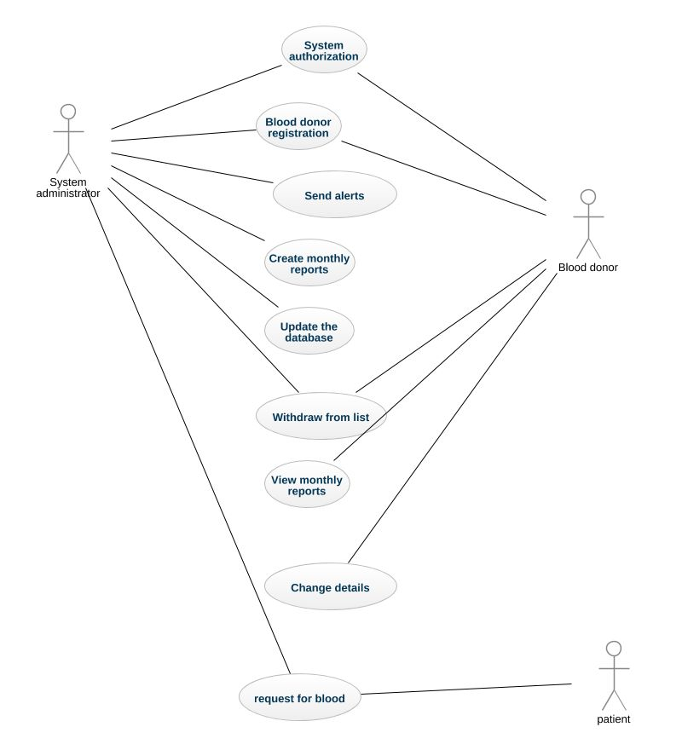
CASE DIAGRAM

Slide 7
1.Admin
2.Blood bank
3.Donor
4.Patient
ADMIN
* Manage Registration for user.
* Manage Blood bank information like (update, delete).
* Manage Donor Request for Donor.
* View Donor information.
* Manage Patient Blood Request.

Slide 8
BLOOD BANK
*View Donor information
*Manage Patient Blood Request.
DONOR
* Manage Donor information(profile)
*Add new Donation for Blood
PATIENT
* Manage patient information(profile)
*Give the Request for patient for blood

Slide 9
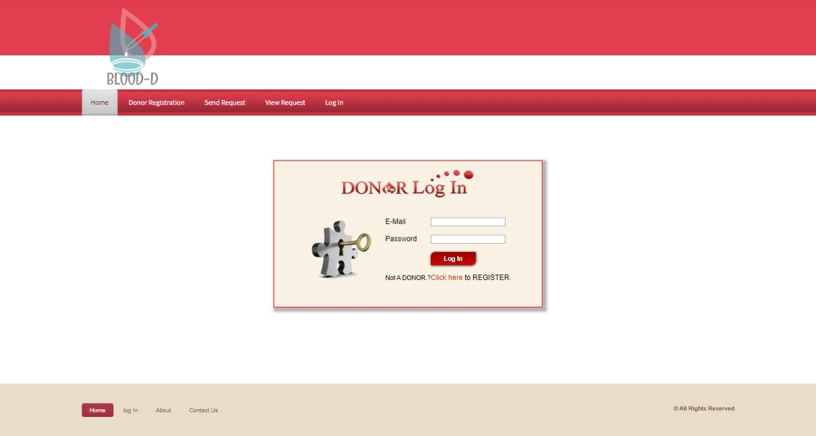
SAMPLE IMAGES

Slide 10
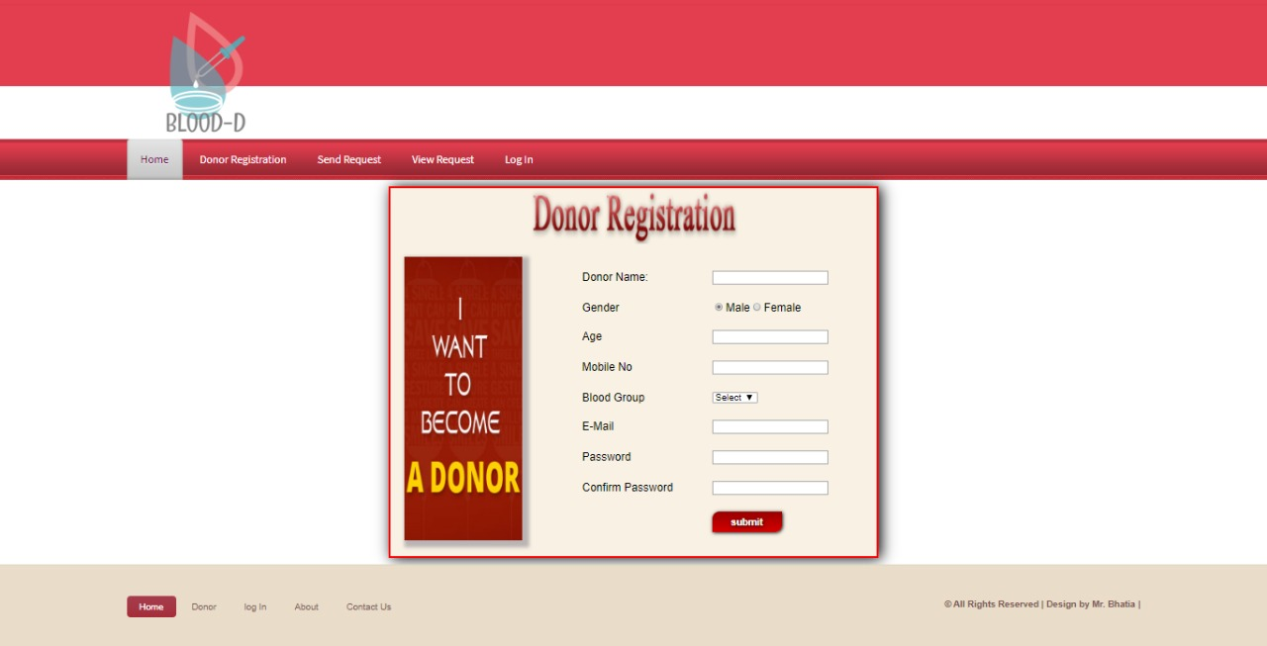

Slide 11
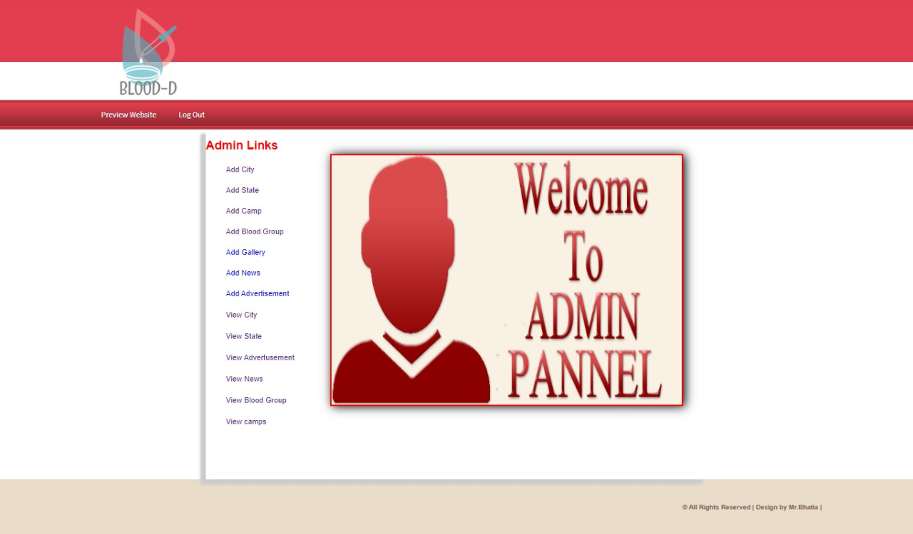

Slide 12
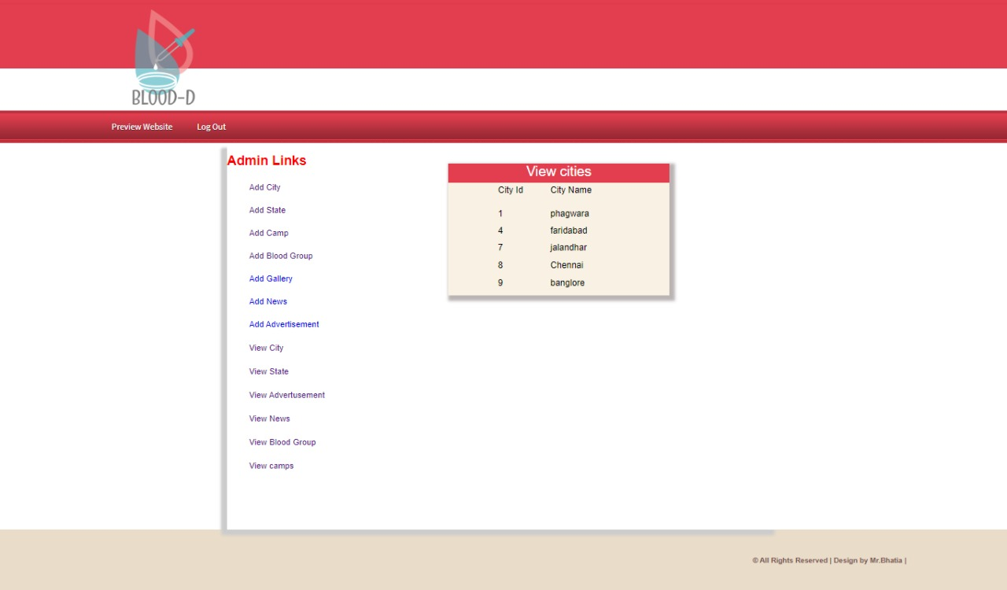

Slide 13
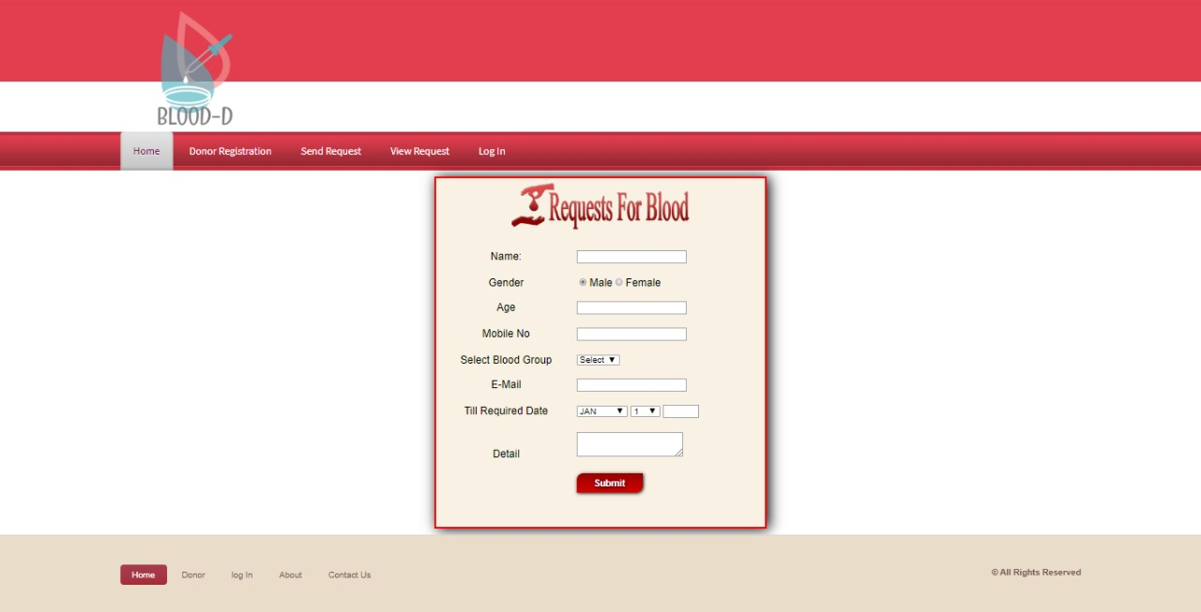

Slide 14
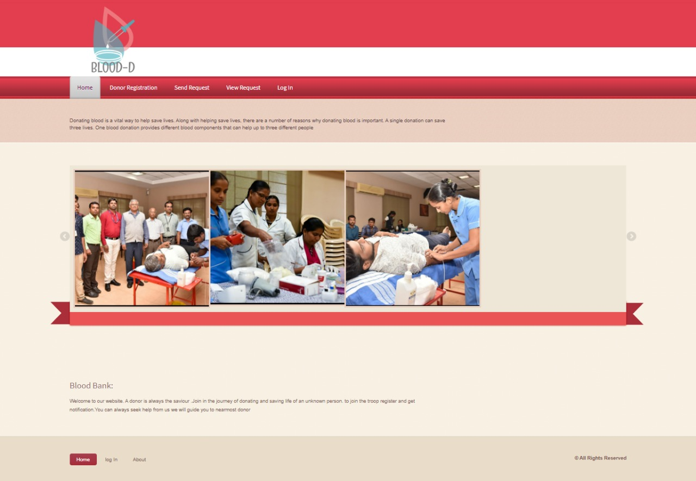

Slide 15
THANK YOU

